Slide 1
Mr. Ulcena
6th - 8th Math
Week at a Glance 08/23-08/27
WAG will continue THE WEEK OF 08/30/2021 DUE TO i-READY TESTING LAST WEEK

Slide 2
Welcome back to school class of 2021-2022
WAG=WEEK AT A GLANCE
Week at a glance (WAG) is designed to give parents a brief idea of what their child is learning at school. It will have the subject standards (Georgia Standards of Excellence), the main topics covered, links to videos and worksheets.
We encourage parents to review this presentation and stay informed on the weekly learning objectives.
WAGS are subject to change according to student mastery.

Slide 3
Math standards
6th Grade
Unit 1
Number System Fluency
Grade 5 Standards
5.NBT.5. 5.NBT.6, 5.NBT.7,
and 5.NF.7a-c
Big Ideas:
Use visual fraction models and equations to divide fractions within real-world contexts.
Fluently add, subtract, multiply, and divide multi-digit decimals and whole numbers using the standard algorithm (6.NS.2-3).
Vocabulary:
Fraction, Whole number, Decimals
7th Grade
Unit 1
Operations with Rational Numbers
Priority Standards
7.NS.1a-d
7.NS.2a, b, c & d
Big Ideas:
Add, subtract, multiply and divide rational numbers including integers in real world & mathematical contexts using a number line and properties (NS.1-2).
Vocabulary:
Rational Numbers, Irrational Numbers
8th Grade
Unit 1
Exponents and Equations
Priority Standards
8.EE.4, 8.EE.7a-b
8.NS.2
Big Ideas:
Add, subtract, multiply, and divide numbers expressed in scientific notation.
Analyze and solve multi-step linear equations.
Use rational approximation of irrational numbers to compare and locate on a number line and estimate value of expressions.
Vocabulary:
Integers, Scientific Notation, Linear Equations

Slide 4
Monday 6th Grade Adding subtracting multiplying and dividing multi-digit decimals and whole numbers PowerPoint presentation./Note taking 7th Grade Add, subtract, multiply and divide rational numbers including integers PowerPoint presentation/Note taking 8th Grade Add, subtract, multiply, and divide numbers expressed in scientific notation. Analyze and solve multi-step linear equations. PowerPoint presentation/Note taking | Tuesday 6th Grade Adding subtracting multiplying and dividing multi-digit decimals and whole numbers PowerPoint presentation./Note taking 7th Grade Add, subtract, multiply and divide rational numbers including integers PowerPoint presentation/Note taking 8th Grade Add, subtract, multiply, and divide numbers expressed in scientific notation. Analyze and solve multi-step linear equations. PowerPoint presentation/Note taking | Wednesday Small Group/Remediation | Thursday I-Ready Math Diagnostic Assessment – ALL grade level | Friday Discuss preassessment with students and set academic goals

Slide 5
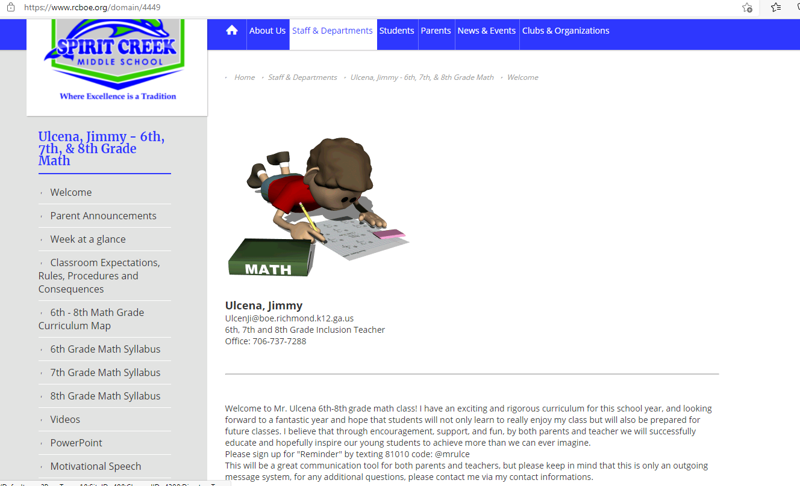
math Resources
For additional resources and weekly PowerPoint and videos click on link to Mr. Ulcena Teacher’s Page
https://www.rcboe.org/domain/4449
Khan Academy
https://www.khanacademy.org/

